Slide 1
Calculating P-Values from Z-test and Permutation-test

Slide 2
The definition of P-Value and Main Idea
P-Value is the probability of getting the observed value of the test statistic, if the null hypothesis is actually true.
The smaller the P-Value, the greater the evidence against null hypothesis.

Slide 3
Example: SAT Scores
You read an article that says the mean math SAT score of the nation's high school grads is 500 with a standard deviation of 110. You think that NJIT freshmen have higher math SAT scores on average than that.
To find that out, you sampled 100 NJIT freshmen and found out their average math SAT score is 533.
Lets find out the P-Value.

Slide 4
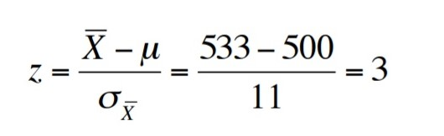
Cont..
To get the P value for your mean, you first convert it to a Z-score.
110/sqrt(100) = 11
p (z > 3) = 1 – 0.9987 (Z table) = 0.0013
http://www.stat.ufl.edu/~athienit/Tables/Ztable.pdf

Slide 5
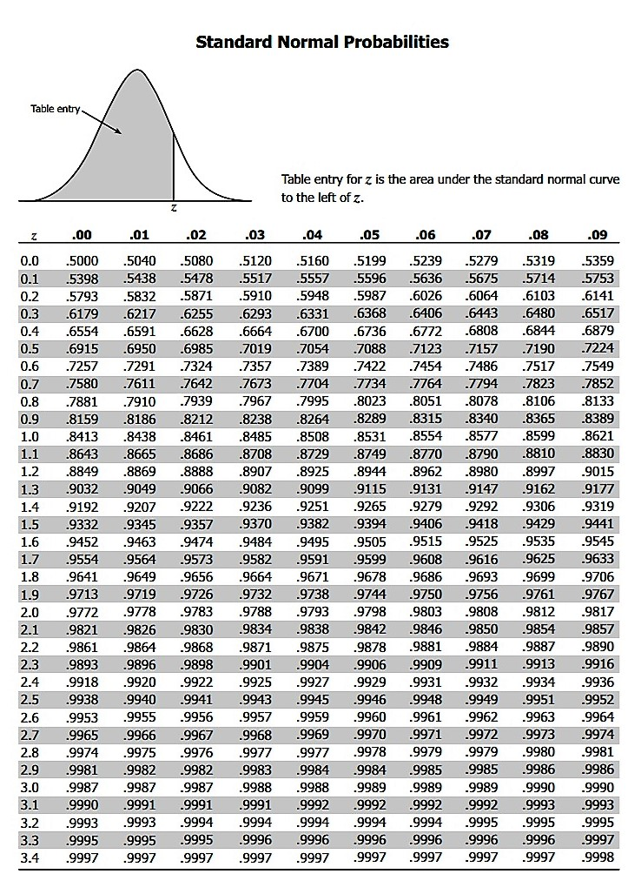
Z Table

Slide 6
Cont..
So, p value for our sample is 0.0013 (0.13%)
We have very good evidence against the null hypothesis.
So, we can say we found great evidence that average math SAT score of NJIT freshmen is higher than the nation's average.

Slide 7
Traffic – Lincoln Tunnel vs Holland Tunnel
Our Hypothesis: Traffic in Lincoln is higher than traffic in Holland tunnel.
Null Hypothesis: Traffic in Lincoln is same as Traffic in Holland tunnel.
Lets calculate P Value using Z-test.

Slide 8
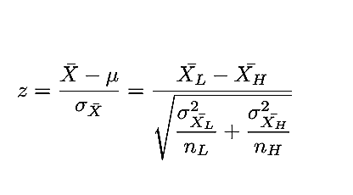
Z value
We need to compute Mean and Standard Deviation for traffic in both Lincoln and Holland tunnels.

Slide 9
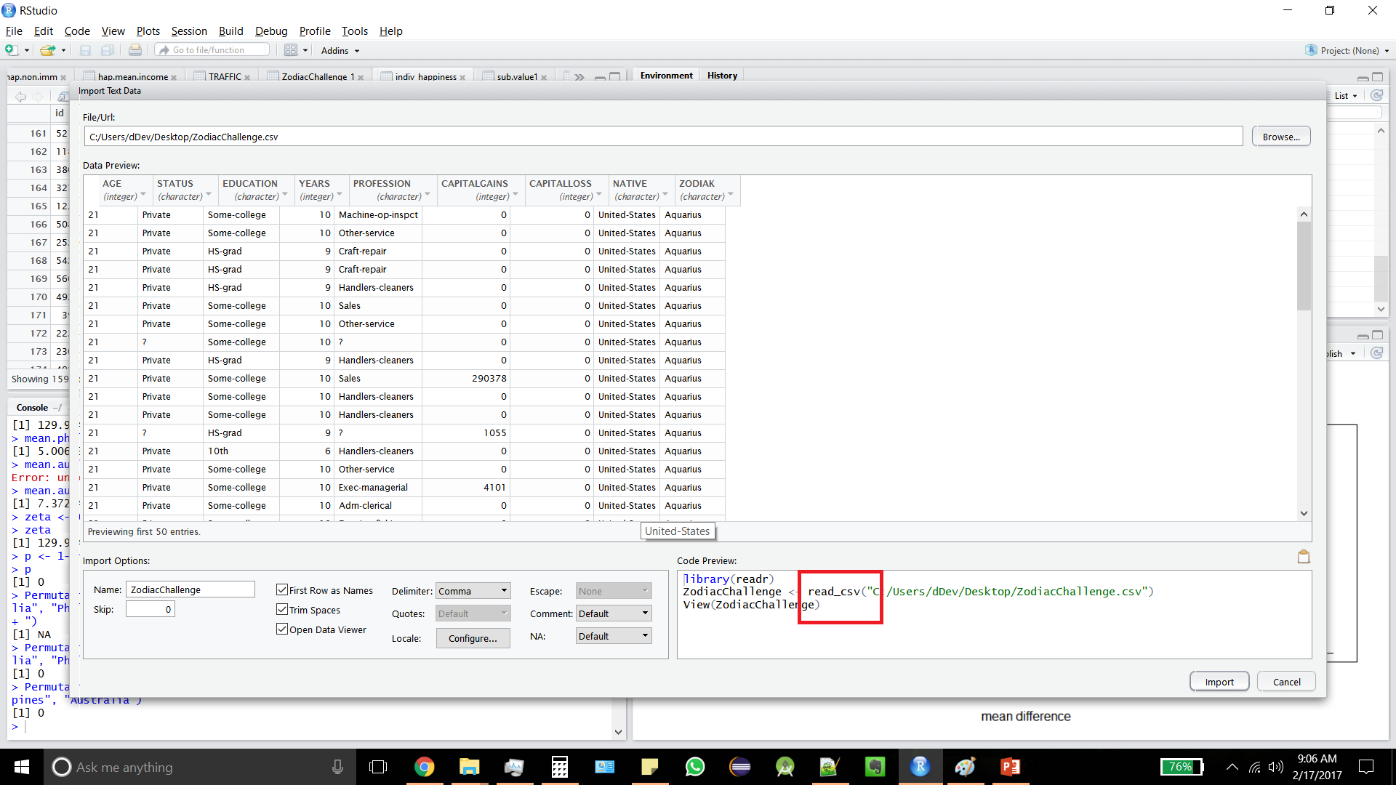
Note : Before performing z-test or permutation test to find p-value - Change read_csv to read.csv

Slide 10
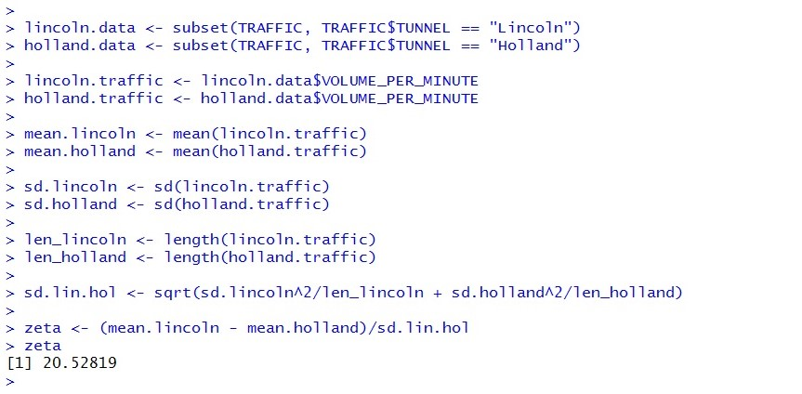
R code

Slide 11
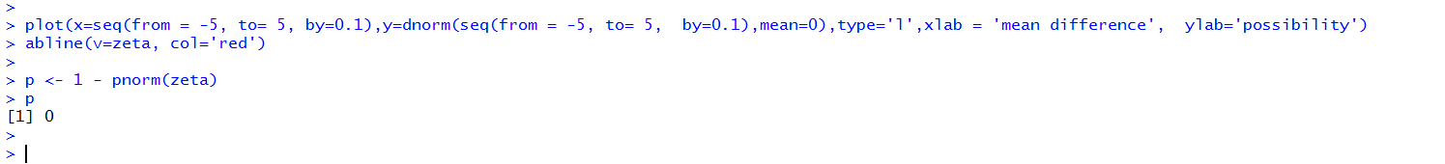
Plots and P Value
http://data101.cs.rutgers.edu/laboratory/pages/ztest
pnorm() is equivalent to checking Z tables.

Slide 12
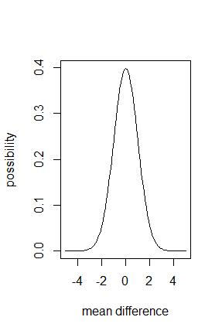
Cont..
We don’t see a red line because p = 0.
We found great evidence to support our hypothesis that traffic in Lincoln is higher.

Slide 13
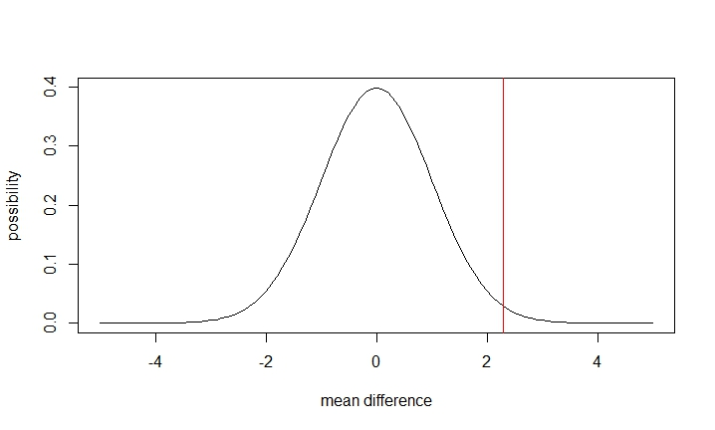
Similar plot for Capital Gains in US vs Capital Gains in Columbia (Zodiac)
p value in this case is 0.01076
We found good evidence to support our hypothesis that Capital Gains in US are higher than Capital Gains in Columbia

Slide 14
Permutation Test
We packaged the code for permutation tests.
Commands to install the package:
> install.packages("devtools")
> devtools::install_github("devanshagr/PermutationTestSecond")

Slide 15
Running the Permutation Test
p value from Permutation Test is 0.
Notice how Z Test and Permutation Test return similar p values.
Notes:
Make sure you use read.csv function to read the data and not read_csv (which is called when you import csv from Rstudio).

Slide 16
Exercise: Compute P-Values for Happiness Dataset
Claim/Hypothesis: People in Philippines are happier compared to people in Australia.

